Slide 1
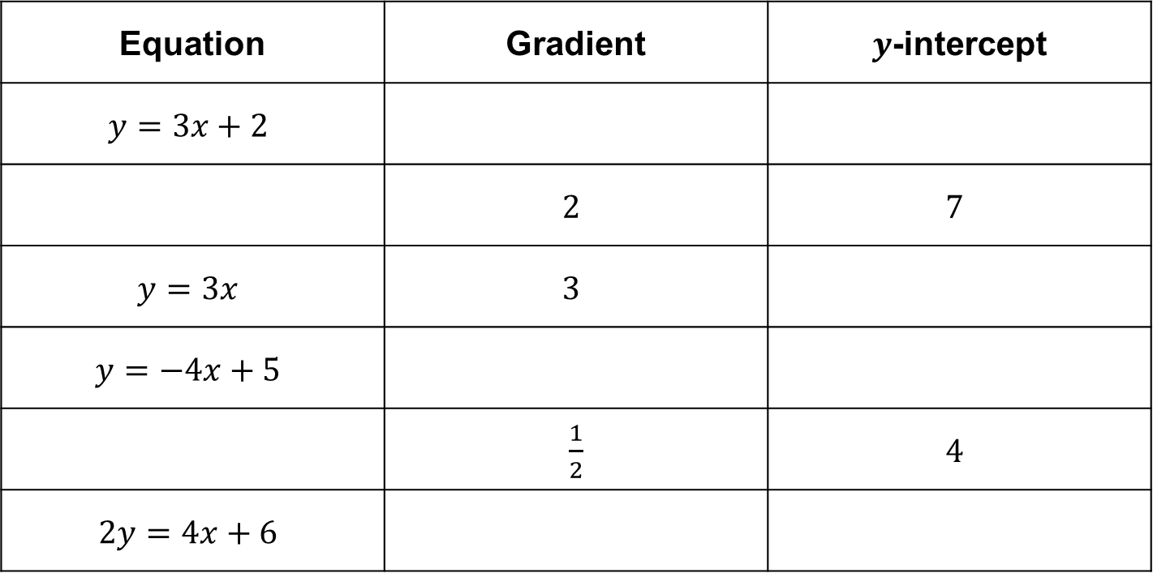
Starter
Copy and complete the following table:
Equation | Gradient | $y$-intercept
$$y=3x+2$$
 | $$2$$ | $$7$$
$$y=3x$$ | $$3$$
$$y=−4x+5$$
 | $\frac{1}{2}$ | $$4$$
$$2y=4x+6$$

Slide 2
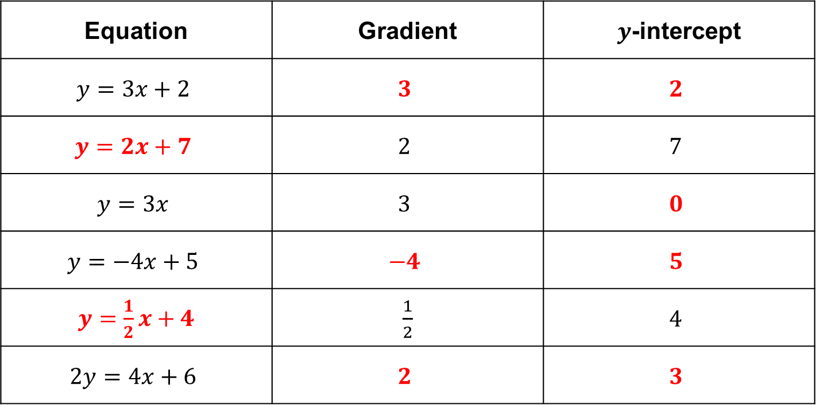
Answers
Equation | Gradient | $y$-intercept
$$y=3x+2$$ | $$3$$ | $$2$$
$$y=2x+7$$ | $$2$$ | $$7$$
$$y=3x$$ | $$3$$ | $$0$$
$$y=−4x+5$$ | $$−4$$ | $$5$$
$y=\frac{1}{2}x+4$ | $\frac{1}{2}$ | $$4$$
$$2y=4x+6$$ | $$2$$ | $$3$$

Slide 3

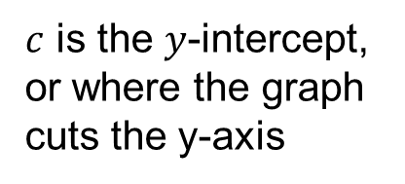
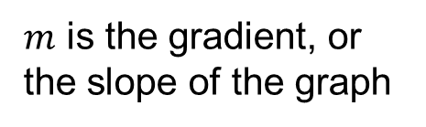
Remember:
$$y=mx+c$$
$m$ is the gradient, or the slope of the graph
$c$ is the $y$-intercept, or where the graph cuts the y-axis

Slide 4
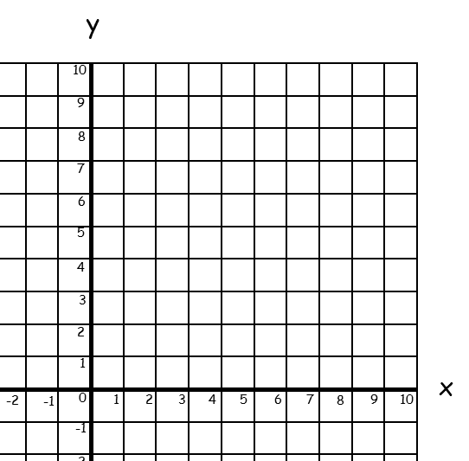

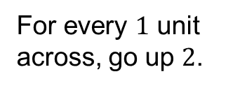
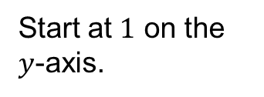
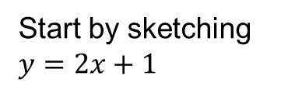
Solve the simultaneous equations $y=2x+1$ and $y=3$ graphically:
Start by sketching $y=2x+1$
Start at $1$ on the $y$-axis.
For every $1$ unit across, go up $2$.
Join with a straight line.

Slide 5
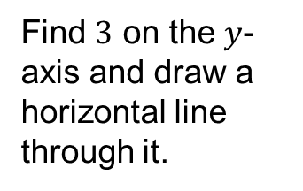
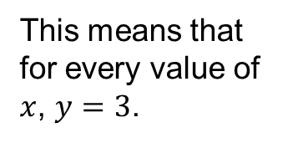

Solve the simultaneous equations $y=2x+1$ and $y=3$ graphically:
Now sketch $y=3$.
This means that for every value of $x$, $y=3$.
Find $3$ on the $y$-axis and draw a horizontal line through it.

Slide 6


Solve the simultaneous equations $y=2x+1$ and $y=3$ graphically:
The solution is the coordinate where the graphs cross.
$$(1, 3)$$
So $x=1$ and $y=3$.

Slide 7
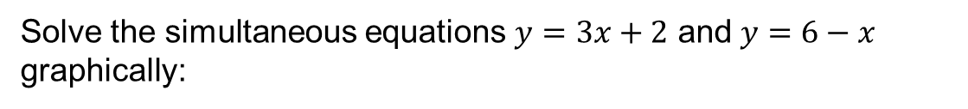
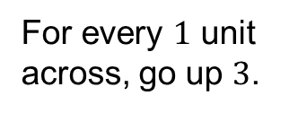
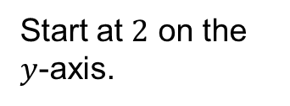
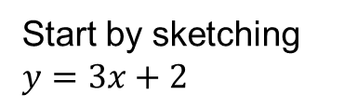
Solve the simultaneous equations $y=3x+2$ and $y=6−x$ graphically:
Start by sketching $y=3x+2$
Start at $2$ on the $y$-axis.
For every $1$ unit across, go up $3$.
Join with a straight line.

Slide 8
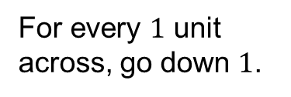
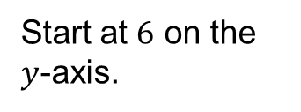

Solve the simultaneous equations $y=3x+2$ and $y=6−x$ graphically:
Now sketch $y=6–x$.
Start at $6$ on the $y$-axis.
For every $1$ unit across, go down $1$.
Join with a straight line.

Slide 9


Solve the simultaneous equations $y=3x+2$ and $y=6−x$ graphically:
The solution is the coordinate where the graphs cross.
$$(1, 5)$$
So $x=1$ and $y=5$.

Slide 10
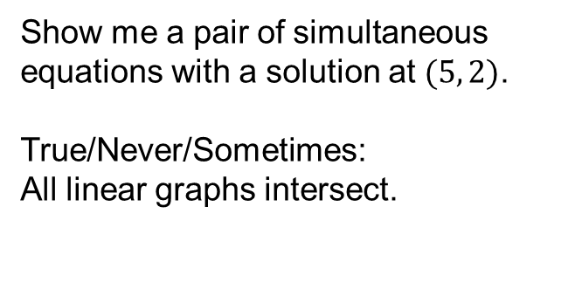
Show me a pair of simultaneous equations with a solution at $(5, 2)$.
True/Never/Sometimes:
All linear graphs intersect.

Slide 12
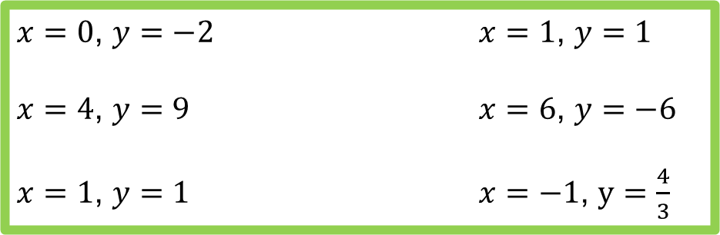
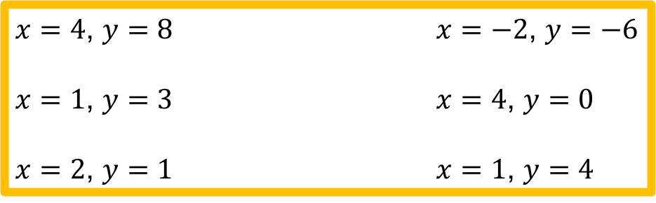
Answers
$x=4$, $y=8$ $x=−2$, $y=−6$
$x=1$, $y=3$ $x=4$, $y=0$
$x=2$, $y=1$ $x=1$, $y=4$
$x=0$, $y=−2$ $x=1$, $y=1$
$x=4$, $y=9$ $x=6$, $y=−6$
$x=1$, $y=1$ $x=−1$, $y=\frac{4}{3}$

